Slide 1


Meet OLIVE
Your AI Shopping Assistant
An Intelligent Virtual Assistant for Retail — Powered by IBM Watson

Slide 2



WHY
RETAILERS NEED A CHATBOT
24/7 Support
Instant Responses
Scalable Service
Customers shop at midnight, weekends, and holidays. Olive never sleeps — providing instant assistance every hour of every day, eliminating wait times and missed opportunities.
73% of shoppers expect replies within seconds. Olive delivers real-time answers on orders, products, returns, and payments — no queue, no delay, no frustration.
One human agent handles 1 chat at a time. Olive handles thousands simultaneously — scaling effortlessly during peak seasons without adding headcount or cost.

Slide 3

How OLIVE
Thinks
Step 1: Understand
User Input
Step 2: Classify
Intent & Entities
Step 3: Route to
Dialog Node
Raw text is received and tokenized. OLIVE reads every word to find meaning, context, and intent signals before responding.
IBM Watson NLU maps the message to a trained intent (the goal) and extracts entities (key data like product names or order IDs).
The matched intent and entities trigger the correct dialog branch, generating a precise, contextual reply back to the user.

Slide 4

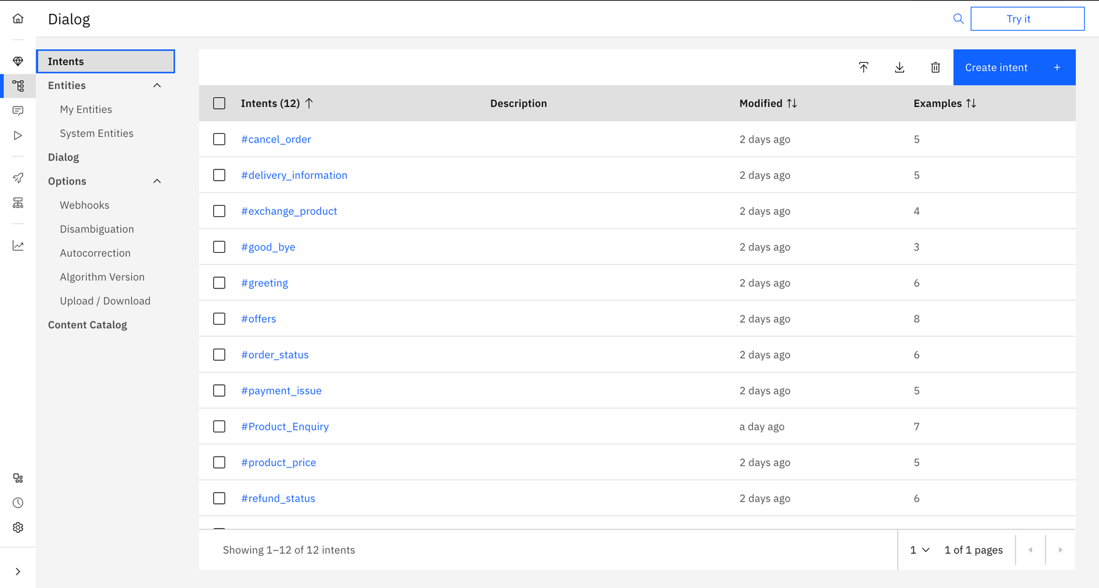

INTENTS
Goals Behind Messages
What is an Intent?
An intent is the goal or meaning behind a user's message — what the user wants to do, not just what they said.

Slide 5

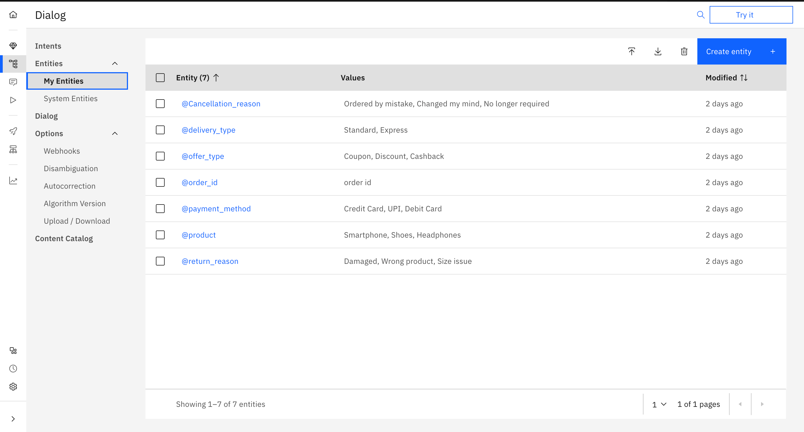
ENTITIES
DEFINED
What is an Entity?
An entity is a specific piece of information extracted from a user's message — the "what" behind the intent. Values and synonyms help Olive recognize natural language variations.

Slide 6
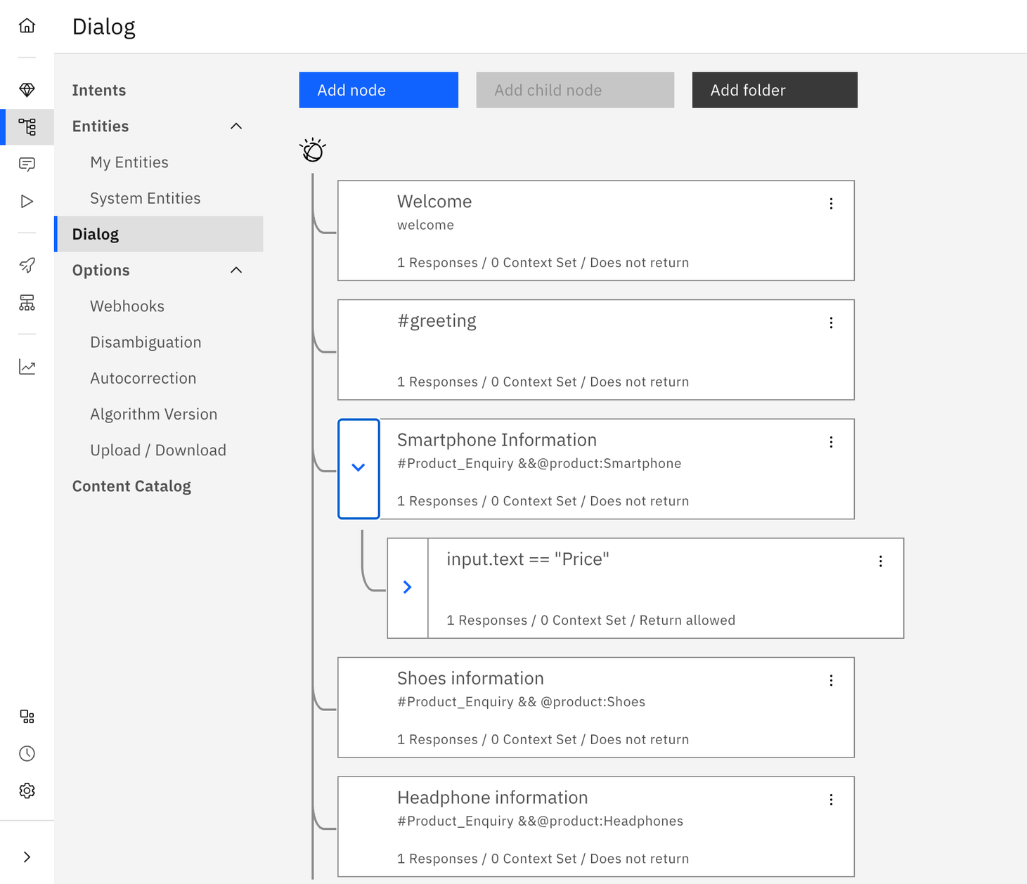


Home
Gallery
Contact
Training
OLIVE

Slide 7
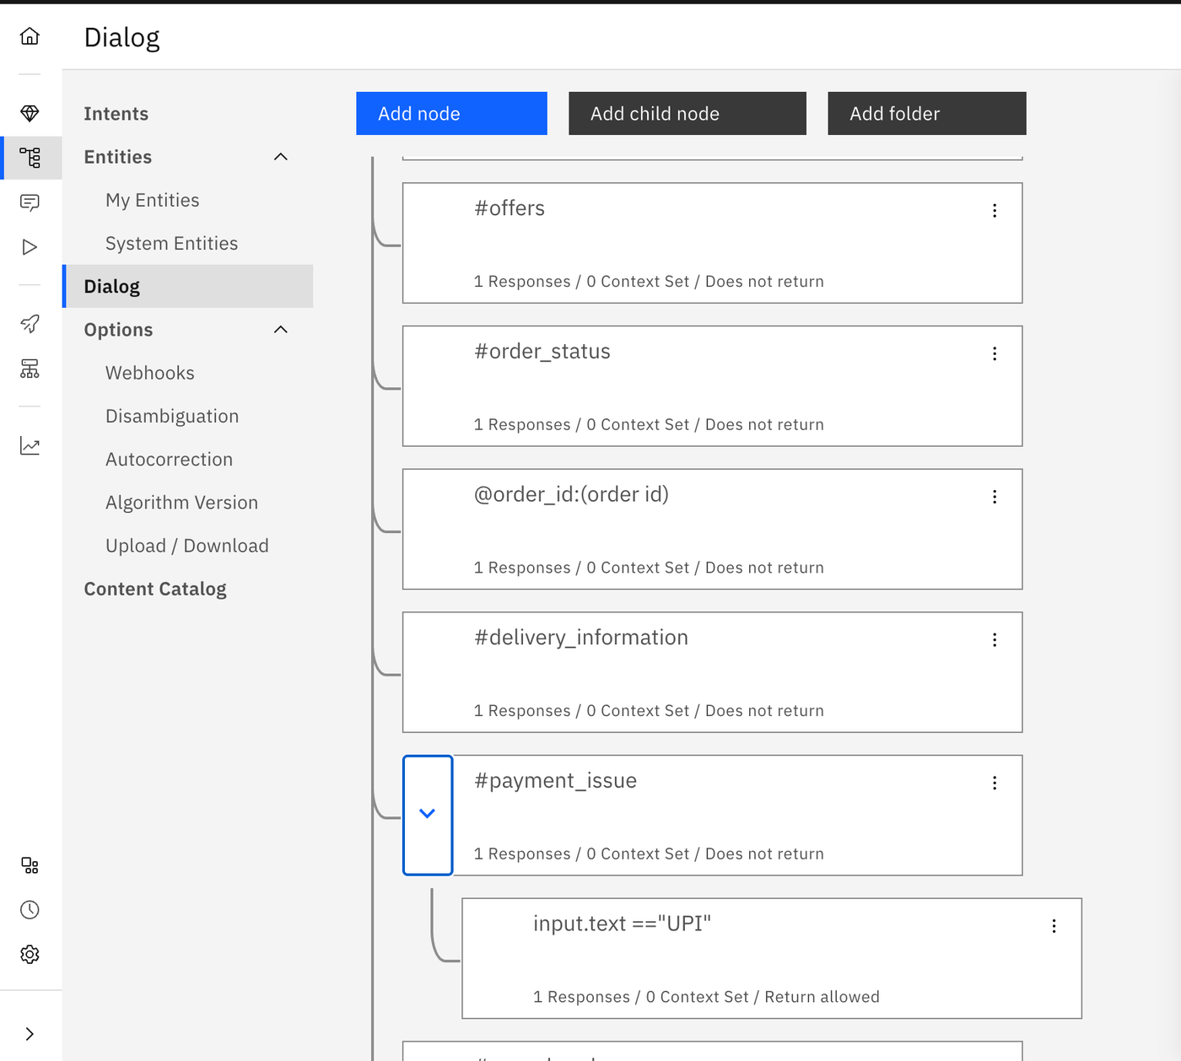
Dialog
Home
Dialog
Nodes
Nodes
A dialog node is a rule-based conversation step that detects a condition and returns a targeted response.

Slide 8

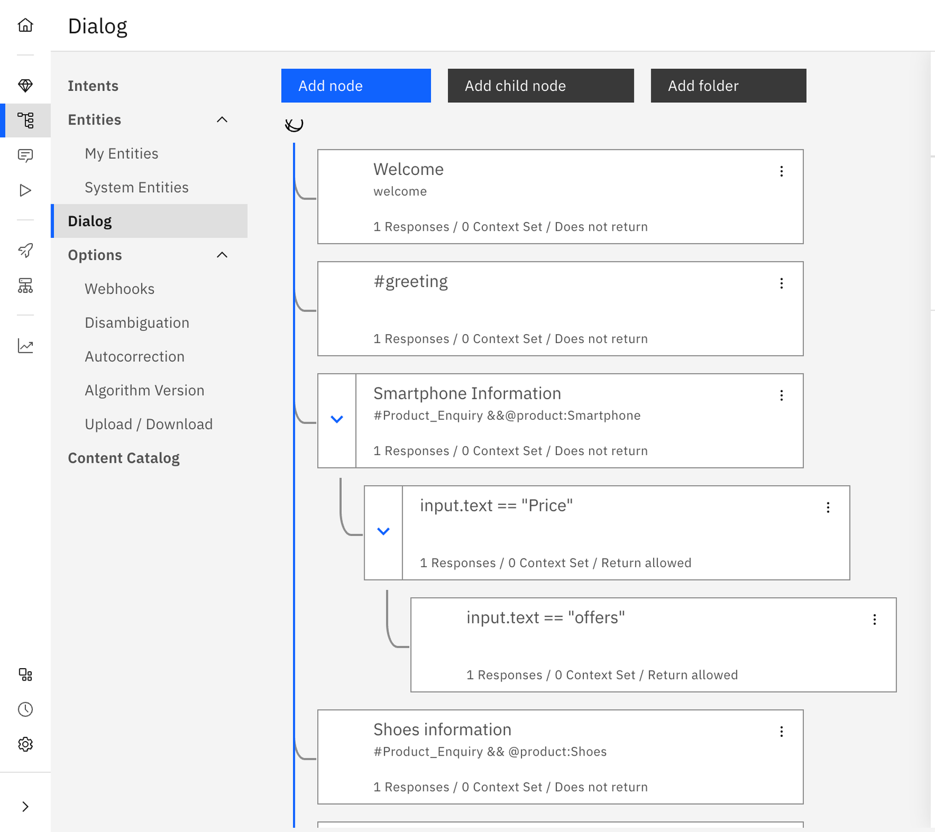

Child
Nodes
A child node is a more specific branch nested under a parent dialog node. When a user's input matches the parent condition, Watson checks child nodes for follow-up conditions — enabling Olive to handle nuanced follow-ups like price inquiries or offer requests within the same conversation turn.

Slide 9




Home
About
Gallery
Contact
Learnings &
Challenges
Training Data
Quality Matters.
Intent Ambiguity
is Tricky.
NLU Has Real Limits.
Watson's NLU struggled with short, vague inputs and slang. Confidence thresholds needed constant tuning to avoid misfires.
Poor or sparse training examples caused Olive to misclassify intents. More diverse, real-world utterances significantly improved accuracy.
Users often mixed intents in one message (e.g., price + refund). Handling multi-intent inputs required careful dialog branching.

Slide 10
OLIVE
Home
About
Gallery
Contact
Future Roadmap
Sentiment Analysis
Voice Integration
Multi-Language Support
Detect customer emotions — frustration, satisfaction, or urgency — in real time. OLIVE adapts tone and escalates to human agents when sentiment signals distress, improving resolution rates and customer trust.
Enable hands-free, speech-driven conversations via voice APIs. OLIVE will process spoken queries, respond audibly, and support accessibility — extending reach to mobile and smart-device users seamlessly.
Train OLIVE across regional languages including Hindi, Tamil, and Bengali. Multilingual NLU models and entity mapping will allow OLIVE to serve India's diverse customer base without language barriers.

Slide 11
Thank
You

